Slide 1
Torque Slip Characteristics of Induction Motor
The torque slip curve for an induction motor gives us the information about the variation of torque with the slip.
The slip is defined as the ratio of difference of synchronous speed and actual rotor speed to the synchronous speed of the machine.
The variation of slip can be obtained with the variation of speed that is when speed varies the slip will also vary and the torque corresponding to that speed will also vary.

Slide 2
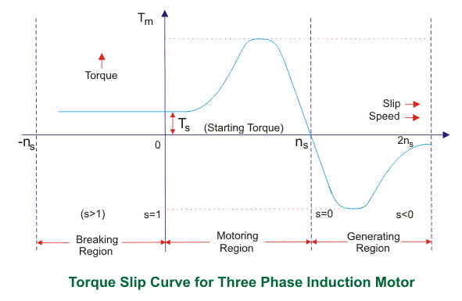
The torque-slip characteristic curve can be divided roughly into three regions:
Low slip region (Generating region)
Medium slip region (Motoring region)
High slip region (Braking region)

Slide 3
Motoring Region In this mode of operation, supply is given to the stator sides and the motor always rotates below the synchronous speed.
The induction motor torque varies from zero to full load torque as the slip varies.
The slip varies from zero to one.
It is zero at no load and one at standstill.
From the curve it is seen that the torque is directly proportional to the slip.
That is, more is the slip, more will be the torque produced and vice-versa.
The linear relationship simplifies the calculation of motor parameter to great extent.

Slide 4
Generating Region
In this mode of operation induction motor runs above the synchronous speed and it should be driven by a prime mover.
The stator winding is connected to a three phase supply in which it supplies electrical energy.
Actually, in this case, the torque and slip both are negative so the motor receives mechanical energy and delivers electrical energy.
Induction motor is not much used as generator because it requires reactive power for its operation.
That is, reactive power should be supplied from outside and if it runs below the synchronous speed by any means, it consumes electrical energy rather than giving it at the output.
So, as far as possible,
induction generators are
generally avoided.

Slide 5
Braking Region
In the Braking mode, the two leads or the polarity of the supply voltage is changed so that the motor starts to rotate in the reverse direction and as a result the motor stops.
This method of braking is known as plugging.
This method is used when it is required to stop the motor within a very short period of time.
The kinetic energy stored in the revolving load is dissipated as heat. Also, motor is still receiving power from the stator which is also dissipated as heat.
So as a result of which motor develops enormous heat energy. For this stator is disconnected from the supply before motor enters the braking mode.
If load which the motor drives accelerates the motor in the same direction as the motor is rotating, the speed of the motor may increase more than synchronous speed.
In this case, it acts as an induction generator which supplies electrical energy to the mains which tends to slow down the motor to its synchronous speed, in this case the motor stops.
This type of breaking principle is called dynamic or regenerative breaking.

